Slide 1

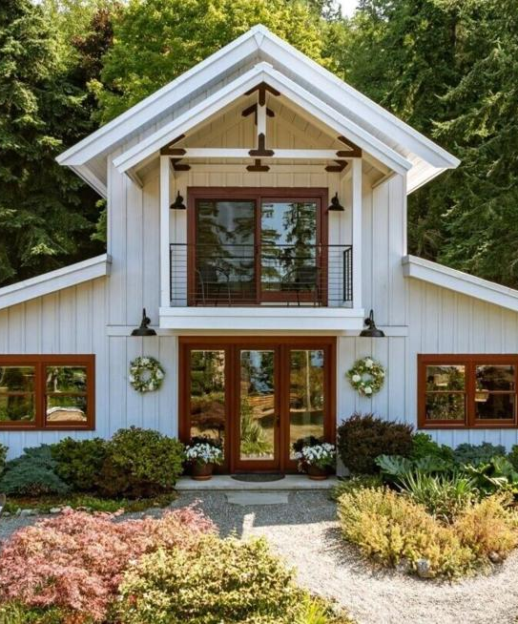
ARTEMIS / LISTING STUDIO
One listing.
An entire
marketing
campaign.
For homeowners, agents and brokerages.
A guided journey and six social films.
01
Notes:
We turn approved source video, photographs and plans into a guided property experience and coordinated campaign. Standard pricing assumes continuous source walkthrough footage. Photo-only reconstruction and true spatial capture are separately scoped.
owner operating brief and approved Cultus Bay demo; 16 September 2026. Property media reference: https://www.zillow.com/homedetails/8015-Cultus-Bay-Rd-Clinton-WA-98236/239638089_zpid/ . Source property media supplied for this demonstration. Client campaigns require permission for the intended media use. ARTEMIS is a working identity pending clearance. No measured outcome data or affiliation with the listing brokerage is claimed.

Slide 2
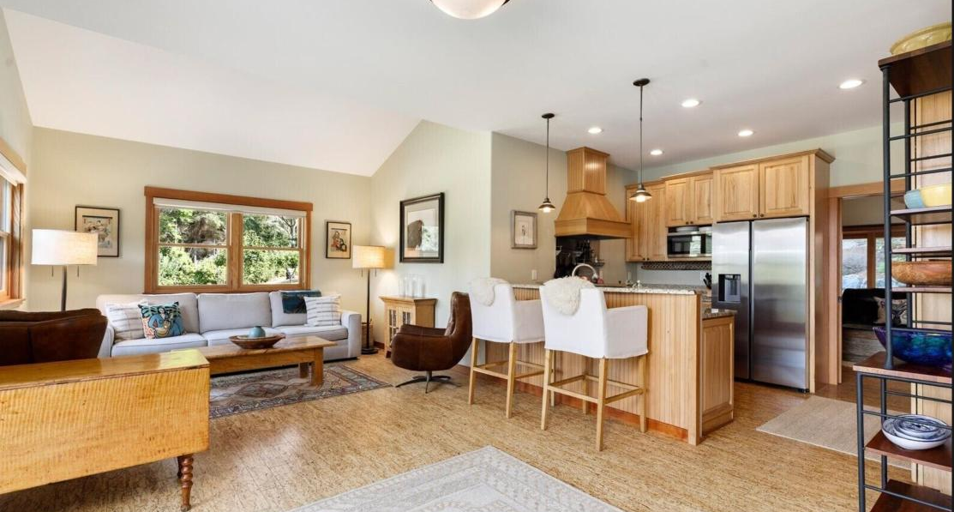
ARTEMIS / LISTING STUDIO
A closer look before the showing
01 Scroll or play
Explore in HD with
helpful room descriptions.
02 Choose a room
Jump to a chapter and
open the source floor plan.
Open the Cultus Bay walkthrough
02
Notes:
Demonstration: open the Cultus Bay walkthrough, scroll or play, choose a room and open the source plan. The roughly 3:18 journey includes separate cottage and barn chapters. This is cinematic AI-assisted visualization rather than measured, free-roaming 3D. HD is an upscale of the approved footage.

Slide 3
ARTEMIS / LISTING STUDIO
The complete listing campaign
01
Interactive property page
02
Cinematic listing film
Mobile journey, room chapters, floor plan and contact CTA.
One guided film, exported for desktop and mobile.
03
Six vertical Reels
04
Website hero clip
Different hooks for social feeds, Stories and Shorts.
A short, silent landscape loop for the listing page.
05
Property highlights
06
Launch copy
Approved property details and consistent presentation.
Six post captions and a property summary.
03
Notes:
Included pilot scope: one standard property, continuous source walkthrough video, original photos and a readable floor plan. One property page, one guided cinematic film up to 3 minutes for the standard property, six 10–30 second vertical cutdowns, one 10–15 second landscape hero clip, approved branding, six captions and one summary. Cultus Bay includes extended detached-building examples beyond the standard pilot scope. Audio in this demonstration is silent; use platform-cleared music or separately approved/licensed audio.
Source: owner operating brief and approved Cultus Bay demo; 16 September 2026. Property media reference: https://www.zillow.com/homedetails/8015-Cultus-Bay-Rd-Clinton-WA-98236/239638089_zpid/ . Source property media supplied for this demonstration. Client campaigns require permission for the intended media use. ARTEMIS is a working identity pending clearance. No measured outcome data or affiliation with the listing brokerage is claimed.

Slide 4
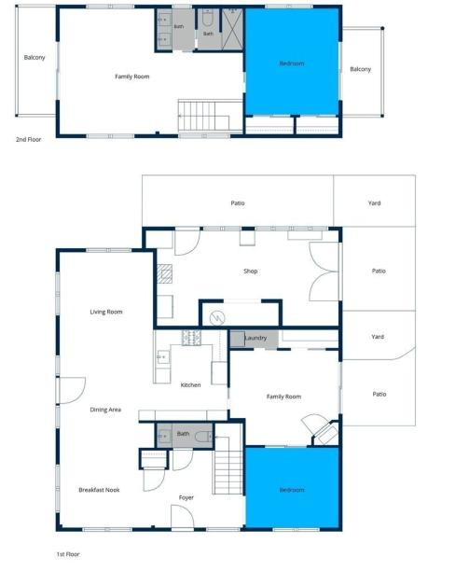
ARTEMIS / LISTING STUDIO
The real home guides the presentation
The plan defines the route.
Source photos verify the connections.
You approve the final presentation.
Clear limits
No invented connecting paths.
No claim of a measured 3D scan.
AI-assisted visuals are disclosed.
04
Notes:
Layout truth comes from the supplied floor plan and real property data, not generation. Check every doorway, room transition, window and staircase against reference material. If continuity cannot be verified, label a separate chapter or request more images; do not invent a bridge. Generative clips can still contain artifacts and require manual approval. A true spatial scan or digital twin is separately scoped and requires real capture data.
Source: owner operating brief and approved Cultus Bay demo; 16 September 2026. Property media reference: https://www.zillow.com/homedetails/8015-Cultus-Bay-Rd-Clinton-WA-98236/239638089_zpid/ . Source property media supplied for this demonstration. Client campaigns require permission for the intended media use. ARTEMIS is a working identity pending clearance. No measured outcome data or affiliation with the listing brokerage is claimed.

Slide 5
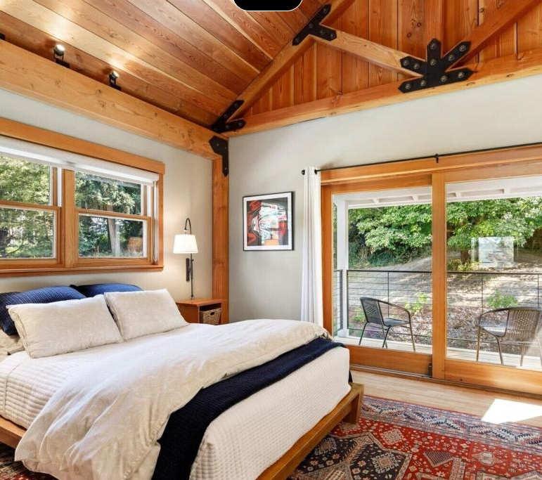
ARTEMIS / LISTING STUDIO
The path from discovery to a showing
Reels create the introduction.
A short hook invites the next click.
The journey explains the home.
Buyers explore rooms and source plans.
The conversation stays with you
Enquiries reach you or your listing agent.
05
Notes:
Position these as intended benefits, not measured results. We currently have no verified client case study proving faster closings, higher prices, more leads or shorter days on market. A strong claim today is that the package supplies consistent listing content and an additional way to explore the property.
Source: owner operating brief and approved Cultus Bay demo; 16 September 2026. Property media reference: https://www.zillow.com/homedetails/8015-Cultus-Bay-Rd-Clinton-WA-98236/239638089_zpid/ . Source property media supplied for this demonstration. Client campaigns require permission for the intended media use. ARTEMIS is a working identity pending clearance. No measured outcome data or affiliation with the listing brokerage is claimed.

Slide 6
ARTEMIS / LISTING STUDIO
Your campaign production process
01 / SEND
02 / REVIEW
03 / LAUNCH
Original photos
and floor plans
One consolidated review
A managed launch
Keep your photographer. Send original photos, clear plans and verified facts. Video is optional for the initial review.
We verify the route and build a first cut. You confirm accuracy and request one revision.
Office plans include publishing after setup. Pilot and team management is separately scoped before purchase.
Target: first review within 3 business days after complete assets and route approval.
06
Notes:
Photo-first intake: original full-resolution exports, overlapping room and doorway views, stair and landing coverage, readable floor plans, verified facts and usage permission. Review source coverage before accepting a continuous route. Existing video is optional. Share https://artemis-listing-studio.thejose12.chatgpt.site/photographer-checklist.html

Slide 7
ARTEMIS / LISTING STUDIO
Listing campaign offers
Offer | Price | Approved scope
Single-property pilot | $500 once | 1 property, six Reels
Team plan | $1,500 / month | Up to 4 properties / month
Office partnership | $5,000 / month | Up to 12 + managed publishing
Upgrade within 30 days: your $500 pilot is credited to the first team month.
Pay $1,000 more. The pilot counts as one of that month’s four properties.
07
Notes:
Owner-approved rates: $500 single, $1,500 for up to four, $5,000 office. Proposed office allowance is 12 video-ready properties, not unlimited volume. Pilot credit applies once within 30 days; the pilot occupies one of the four team slots. Monthly plans paid in advance, no rollover. Confirm capacity before purchase. Applicable taxes additional. Each property includes six Reels. Office scope is described on the office slide.

Slide 8
ARTEMIS / LISTING STUDIO
Standard production scope
Included
Separately scoped
One home with approved visual coverage
Original photos and readable floor plan
One consolidated revision
90 days of pilot property-page hosting
Six Reels and final marketing assets
Complex or missing source coverage
On-site capture and detached buildings
Extra revisions or rush production
Paid ads and individual-agent channels
Custom domains and large integrations
No guarantees of leads, sale price, days on market or closing time.
08
Notes:
Renewal terms are quoted and accepted before the included 90-day hosting period ends; do not imply perpetual hosting. Team property hosting remains active during subscription, with 90 days after cancellation for already delivered pages. Client-supplied materials must be licensed for AI processing, editing and intended distribution; permission from a listing agent alone may not cover photographer rights. Request applicable brokerage and MLS approval. This slide states commercial scope, not a substitute for a signed service agreement.
Source: owner operating brief and approved Cultus Bay demo; 16 September 2026. Property media reference: https://www.zillow.com/homedetails/8015-Cultus-Bay-Rd-Clinton-WA-98236/239638089_zpid/ . Source property media supplied for this demonstration. Client campaigns require permission for the intended media use. ARTEMIS is a working identity pending clearance. No measured outcome data or affiliation with the listing brokerage is claimed.

Slide 9
ARTEMIS / LISTING STUDIO
Your home, thoughtfully presented
Let buyers experience what makes it yours.
Follow the rooms and explore the distinctive details.
Six short films bring those spaces to social feeds.
One property page gives interested buyers a closer look.
Selling with an agent? Ask them to include ARTEMIS in your listing campaign.
09
Notes:
Address homeowners directly. Invite them to share the seller page with their existing agent. The approved demo illustrates the deliverables; it does not establish faster sales, higher prices or measured spatial accuracy. The source photos and plans remain the property reference.

Slide 10
ARTEMIS / LISTING STUDIO
Selling your home yourself
A complete campaign for your property
The $500 pilot includes the guided walkthrough, six Reels
and a property page using your approved source media.
Your contact details direct enquiries to you.
You handle buyer conversations and viewings.
We create the marketing. Property sales advice stays with your chosen professional.
10
Notes:
Fixed-price marketing production for one video-ready home. Review source footage, plans, facts and rights before payment. One consolidated revision and 90 days of pilot-page hosting. Photos alone may require a separately scoped production. No brokerage representation, guaranteed leads, sale-price increase or closing-time claim. If the seller has an agent, agree contact routing with them.

Slide 11
ARTEMIS / LISTING STUDIO
The $5,000 office partnership
12 properties each month
Six Reels per property
Managed publishing to four office channels
One existing booking connection
Monthly post and tour activity reporting
Your practical AI technology partner
Two automation/support hours + one coordination hour monthly.
Larger projects and higher listing volumes receive a separate quote.
11
Notes:
Managed launch scope: six creative Reels per listing, up to four connected office channels, up to 24 placements per property over 14 days, with schedule approval and publishing-status checks. One monthly report separates available social metrics, attributable tour visits and contact actions from confirmed enquiries. Setup and testing of account access, measurement and contact routing precede launch. Platform metric availability differs. No live integrations are demonstrated by the Cultus Bay example. Blotato documentation: https://help.blotato.com/api/llm

Slide 12
ARTEMIS / LISTING STUDIO
A seller request can start an office partnership
01
02
03
A homeowner asks
for the presentation
Their agent starts
with one property
The office reviews
the campaign and
chooses its scope
Each step depends on fit and results. Start with one complete property campaign.
12
Notes:
Proposed sales journey, not a forecast. A homeowner can request ARTEMIS, an agent can purchase a pilot, and an office can choose a recurring scope after evaluating delivery. Office support is limited to the stated hours and listing allowance.

Slide 13
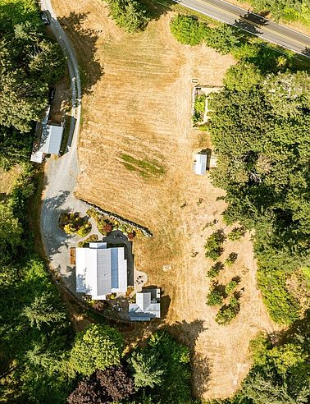
ARTEMIS / LISTING STUDIO
$500
One property.
Your first
complete campaign.
Send your home address and available media.
We’ll confirm scope and a delivery date.
Jose Garcia · jose@artemisautomation.ai
13
Notes:
Close with a small commitment: Is there one current or upcoming listing you would like to review for the founding pilot? Ask for the address, source-media access and a short call. Confirm media permissions and route feasibility before sending the payment request. Contact: jose@artemisautomation.ai, provided by Jose.
Source: owner operating brief and approved Cultus Bay demo; 16 September 2026. Property media reference: https://www.zillow.com/homedetails/8015-Cultus-Bay-Rd-Clinton-WA-98236/239638089_zpid/ . Source property media supplied for this demonstration. Client campaigns require permission for the intended media use. ARTEMIS is a working identity pending clearance. No measured outcome data or affiliation with the listing brokerage is claimed.

